Slide 1

Project Report Presentation
on
CityTwin AI:
An AI-Powered Digital Twin Platform for Smarter Urban Planning and Decision-Making
Presented By
Aman (2411981063)
Akshit Jareat (2411981054)
Ansh Goyal (2411981092)
Aniket Chauhan (2411981078)
School of Engineering and Technology
Under the Supervision
Of
Dr. Vidhu Baggan
Chitkara University,Himachal Pradesh

Slide 2
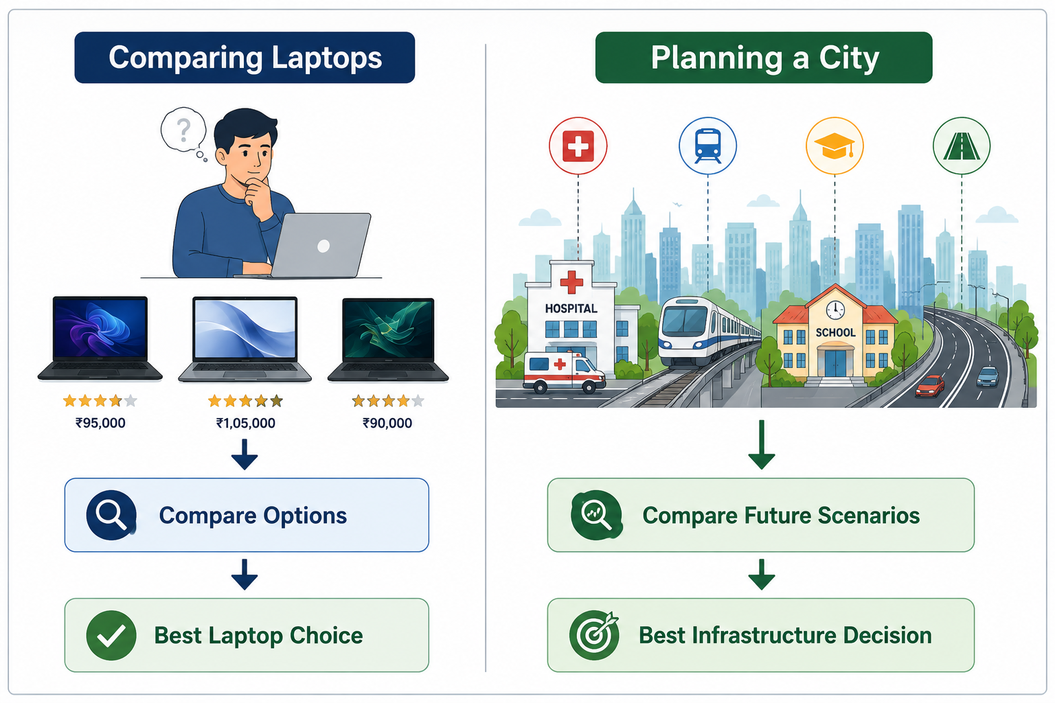
Introduction
Figure 1: If we do this for a laptop, why not for a city's future?
If we compare multiple options before buying a ₹1 lakh laptop, shouldn't governments do the same before investing thousands of crores in building a city's future?

Slide 3
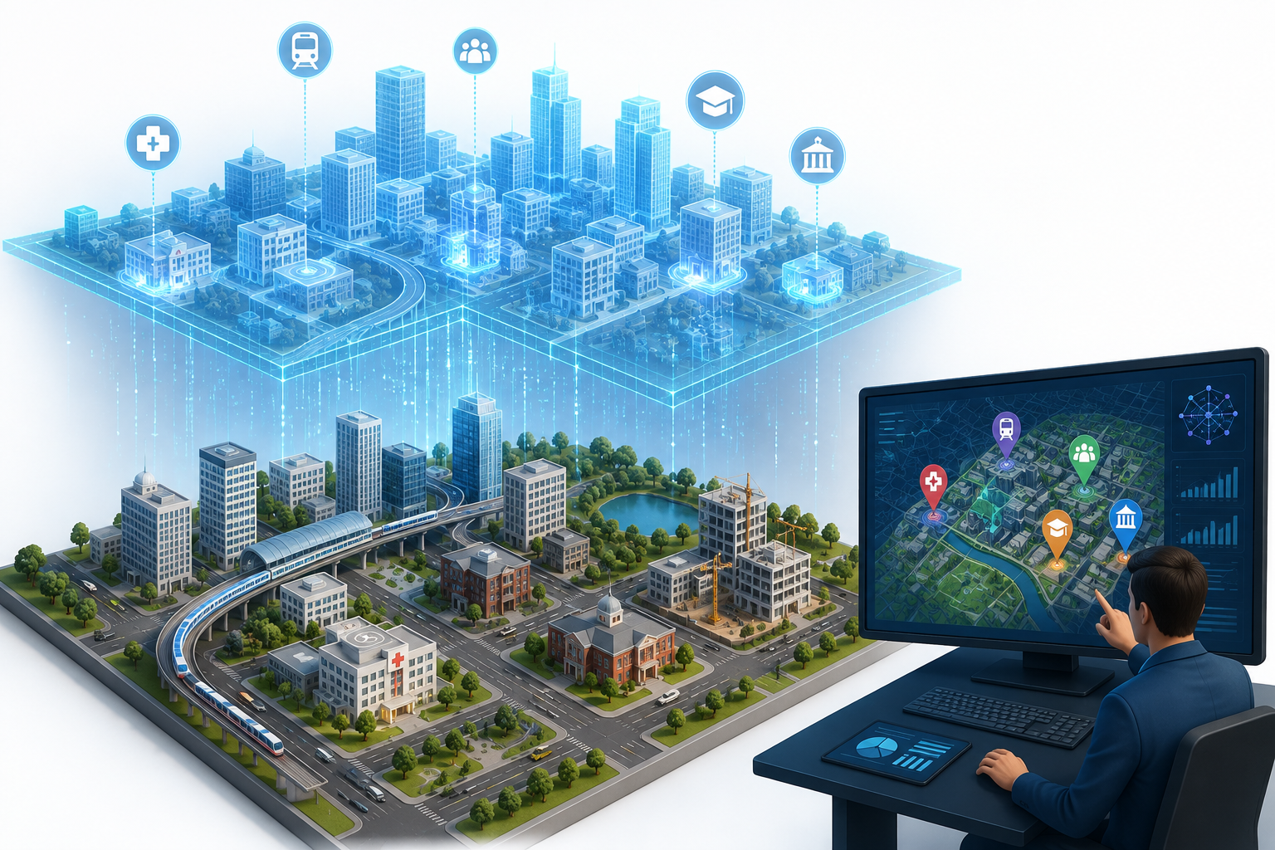



Introducing CityTwin AI
CityTwin AI is an AI-powered Digital Twin that analyzes urban data, predicts future growth, and recommends optimal locations for hospitals, metro routes, schools, and other public infrastructure.
AI Component
Forecast infrastructure demand
Recommend optimal facility locations
Simulate multiple planning scenarios
Generate explainable AI recommendations
Innovation
AI + Digital Twin + GIS
Predict before building infrastructure
Virtual city scenario simulations
Future-ready urban decision support

Slide 4
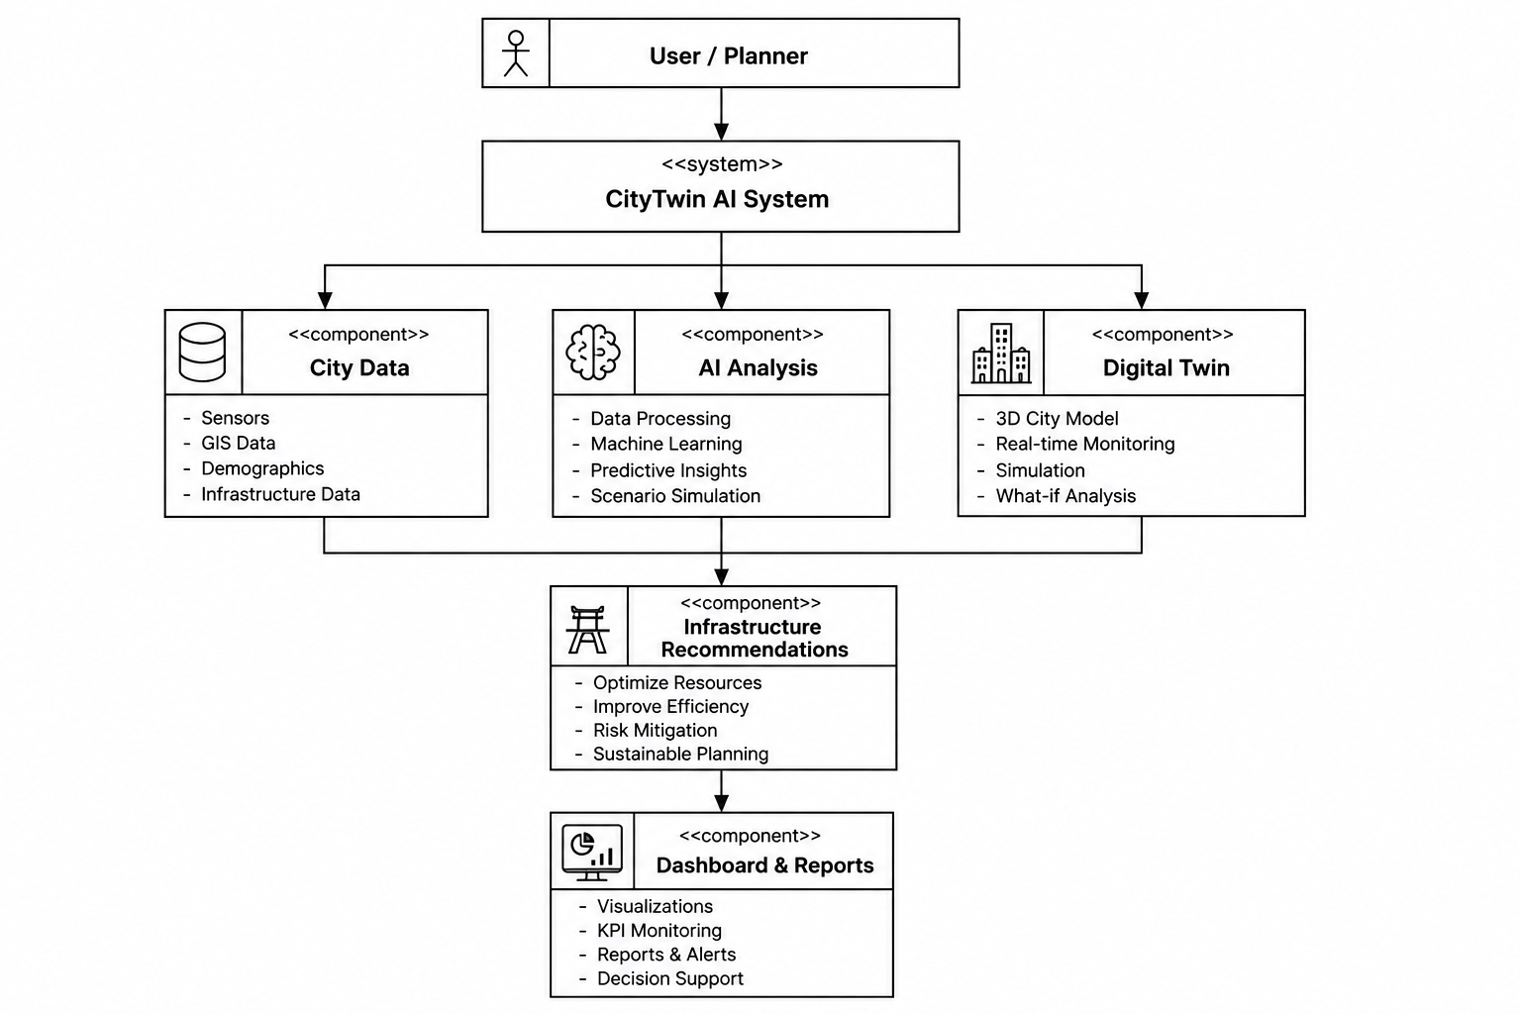
System Design (Flowchart)
Figure 2: Workflow of the CityTwin AI System

Slide 5
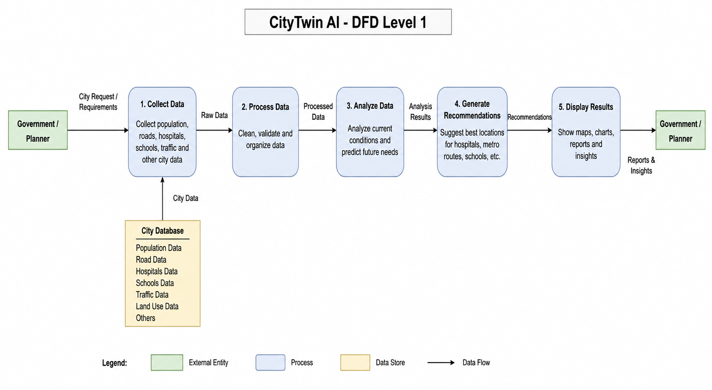
System Design (DFD Level 1)
Figure 3: Data Flow Diagram (DFD) Level 1 of CityTwin AI

Slide 6
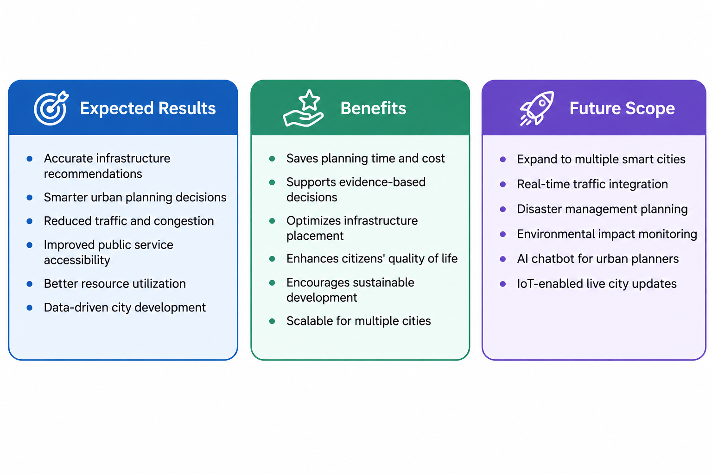
Expected Outcome

Slide 7
References
OpenStreetMap Contributors. OpenStreetMap. https://www.openstreetmap.org
Government of India. Open Government Data (OGD) Platform India. https://data.gov.in
ESRI. What is GIS? https://www.esri.com/en-us/what-is-gis/overview
Microsoft. Azure Digital Twins Documentation. https://learn.microsoft.com/azure/digital-twins/
Google Maps Platform Documentation. https://developers.google.com/maaps
World Bank. Smart Cities and Urban Development. https://www.worldbank.org
Google Gemini API – https://ai.google.dev/
MDN Web Docs – https://developer.mozilla.org/

Slide 8
THANK YOU
Presented by:
Aman (2411981063)
Akshit Jareat (2411981054)
Ansh Goyal (2411981092)
Aniket Chauhan (2411981078)
Department of CSE
Chitkara University
The cities of tomorrow are planned by the decisions we make today.

